Slide 1
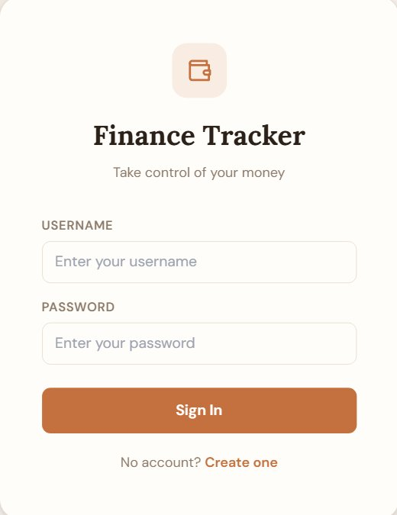

Finance Tracker
Take control of your money
Group Members:
Deepak Kumar 25K-5636
Asma Atif 25K-5550
Muhammad Razi Hussain 25K-5666
Built with Python · CSV · Matplotlib

Slide 2
Project Overview
Finance Tracker is a multi-user, CSV-based personal finance management application. It enables users to track daily expenses, manage debts, set savings goals, define category budgets, and visualize financial data — all from a clean menu-driven interface built entirely in Python.
Multi-User Auth
Expense Tracking
Register & login with CSV-backed user storage
Add, view, delete expenses by category & date
Debt Management
Visual Analytics
Track debts, repayments, remaining balances
5 pie charts: category, monthly, savings, debt, budget

Slide 3






Key Features
Expense Logger
Debt Tracker
Budget Goals
Track amounts, categories & auto-timestamped dates per entry
Add creditors, record repayments, see remaining balances
Set per-category limits; get warnings when exceeded
Savings Manager
5 Visual Charts
Secure Auth
Define a target and log contributions to track progress
Pie charts for category, monthly, savings, debt, budget
Register/login with password; fully isolated per-user data

Slide 4





How It Works
A step-by-step walkthrough of the user journey inside Finance Tracker
01
02
03
04
05
Register
Login
Manage Data
View Analytics
Track Progress
Create a new account with a unique username & password stored in users.csv
Authenticate credentials; session is active until the user logs out
Add expenses, debts, set budgets, and update savings from the main menu
Generate live pie charts — category, monthly, savings, debt, or budget view
Monitor savings goals, remaining debts, and budget warnings over time

Slide 5
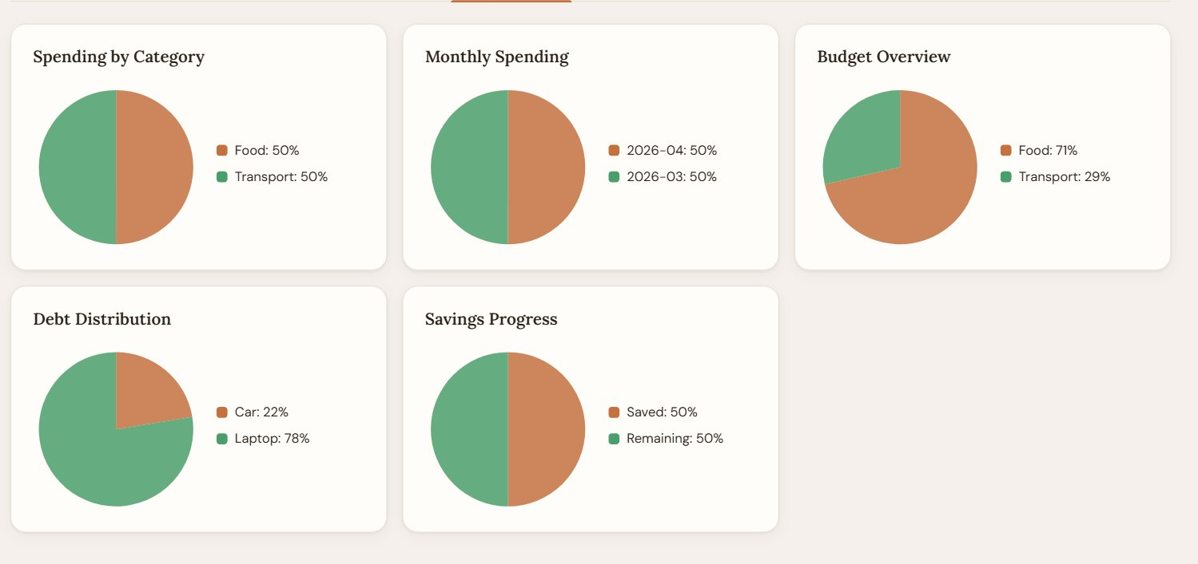
Graphs & Analytics
Spending by Category
Pie chart of total spend per category — Food, Transport, etc.
Monthly Spending
Month-wise expense breakdown across YYYY-MM buckets
Budget Overview
Compares actual spend vs per-category budget limits
Debt Distribution
Remaining balances per creditor shown as pie slices
Savings Progress
Saved vs remaining amount towards the user's goal

Slide 6
Technology Stack
Python 3
All business logic, file handling, menus, and validation written in pure Python.
Core Language
CSV Files
Five CSV files: users, expenses, debts, budgets, savings — no database required.
Data Storage
Matplotlib
Generates 5 real-time pie charts for expense, debt, savings, and budget analysis.
Data Visualization
Datetime
Auto-generates YYYY-MM-DD timestamps for every expense entry logged.
Date & Time Handling
No external frameworks or databases — fully portable, runs on any system with Python 3 installed.

Slide 7
Data Architecture
users.csv
Stores all registered user credentials
id · username · password
expenses.csv
Every expense entry with auto-generated date-stamp
id · user_id · amount · category · date
debts.csv
Tracks creditors and repayment progress
id · user_id · name · total · remaining
budgets.csv
Per-category spending limits per user
id · user_id · category · limit
savings.csv
Savings target and current accumulated amount
user_id · goal · current

Slide 8
Finance Tracker
A complete personal finance solution — built in Python, powered by CSV
CSV-Powered Storage
Multi-User Security
Visual Analytics
Zero Dependencies
Thank You!

